Slide 1

ML_PROJECT2:
Breast Cancer Prediction Using Logistic Regression
An AI-driven approach to early diagnosis and classification of breast tumors.
Submitted By Shati Biswas

Slide 2



Problem Statement & Aim
Early and accurate diagnosis of breast cancer is crucial for effective treatment. This project aims to develop a machine learning system using Logistic Regression to predict breast cancer nature (malignant/benign).
1
2
Train Model
Evaluate Accuracy
Train a logistic regression model on labeled data.
Assess the model's performance and reliability.
3
Aid Diagnosis
Support medical professionals in early detection.

Slide 3


Project Overview
This project focuses on building a lightweight, interpretable, and efficient tool for breast cancer prediction.
Core Task
Predicting malignant or benign breast cancer using logistic regression.
Technology Stack
Python, NumPy, Pandas, Scikit-learn.

Slide 4
Motivation / Business Relevance
High demand for early screening tools
AI assistance in diagnostics saves time and resources
Reduces diagnostic errors

Slide 5

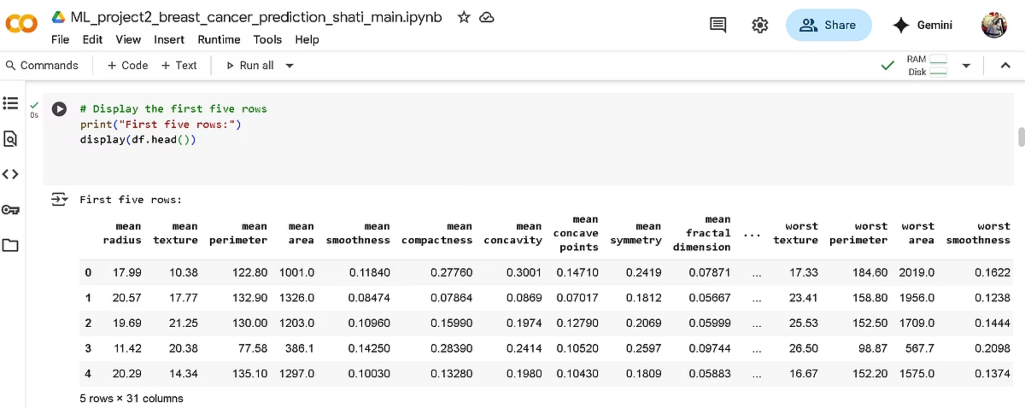
DATASET:
Data Collection & Loading
The Breast Cancer Wisconsin Diagnostic Dataset is imported from sklearn.datasets and loaded into a Pandas DataFrame.

Slide 6

Exploratory Data Analysis (EDA)
Key steps in understanding the dataset's structure and characteristics.
Dataset Overview
Missing Values
Display first/last five rows, check shape, and info.
Verify no missing data using .isnull().sum().
Summary Statistics
Target Distribution
Analyze feature distributions with .describe().
Examine benign (357) vs. malignant (212) samples.

Slide 7
Data Preprocessing & Model Training
Preparing the data and training the Logistic Regression model.
Data Split
Model Training
Features (X) and target (Y) are separated. The dataset is split into 80% training and 20% testing sets, stratified to maintain class proportions.
A Logistic Regression model is initialized with max_iter=10000 and trained on the training data.

Slide 8
Model Evaluation: Key Metrics
The model demonstrates high performance across various metrics.
0.96
0.97
0.97
0.97
Accuracy
Precision
Recall
F1 Score
Both training (0.958) and test (0.965) accuracies are high, indicating no overfitting.
97.22% of predicted positive instances were actually positive.
97.22% of actual positive instances were correctly identified.
A high F1 score indicates a balanced performance between precision and recall.

Slide 9
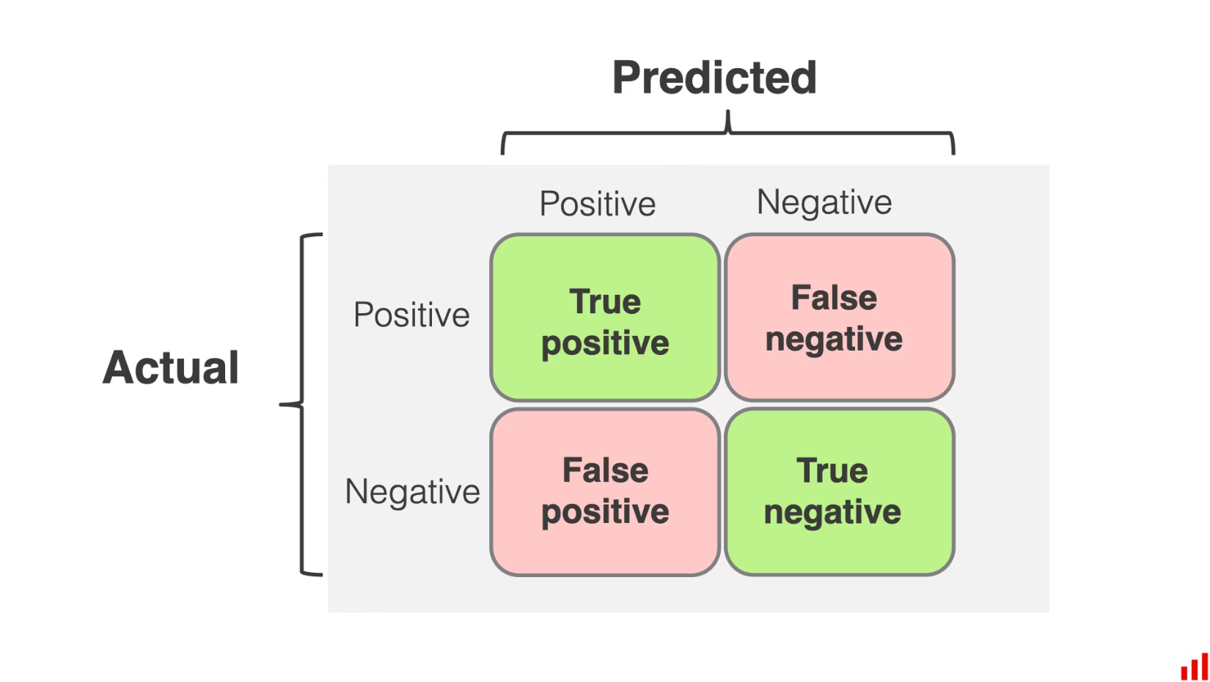
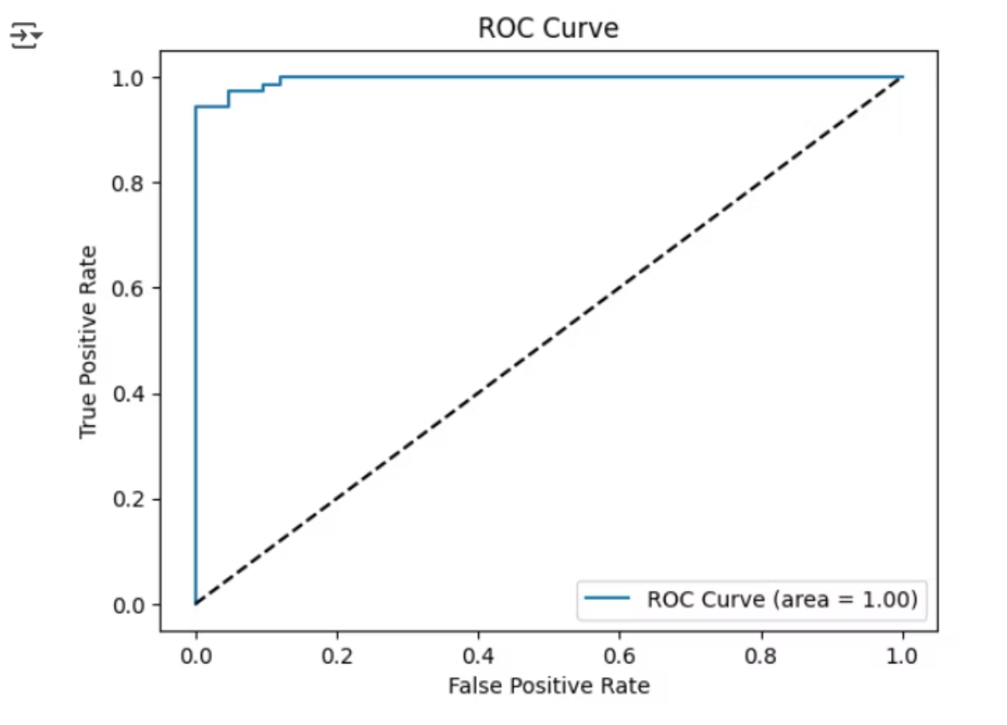
Model Evaluation: Visualizations
Visual tools confirm the model's excellent discriminatory power.
Confusion Matrix
ROC Curve & AUC
Correctly identified 40 malignant (TN) and 70 benign (TP) cases. Only 2 false positives and 2 false negatives.
An AUC of 1.00 indicates a perfect model, capable of distinguishing between malignant and benign cases.

Slide 10
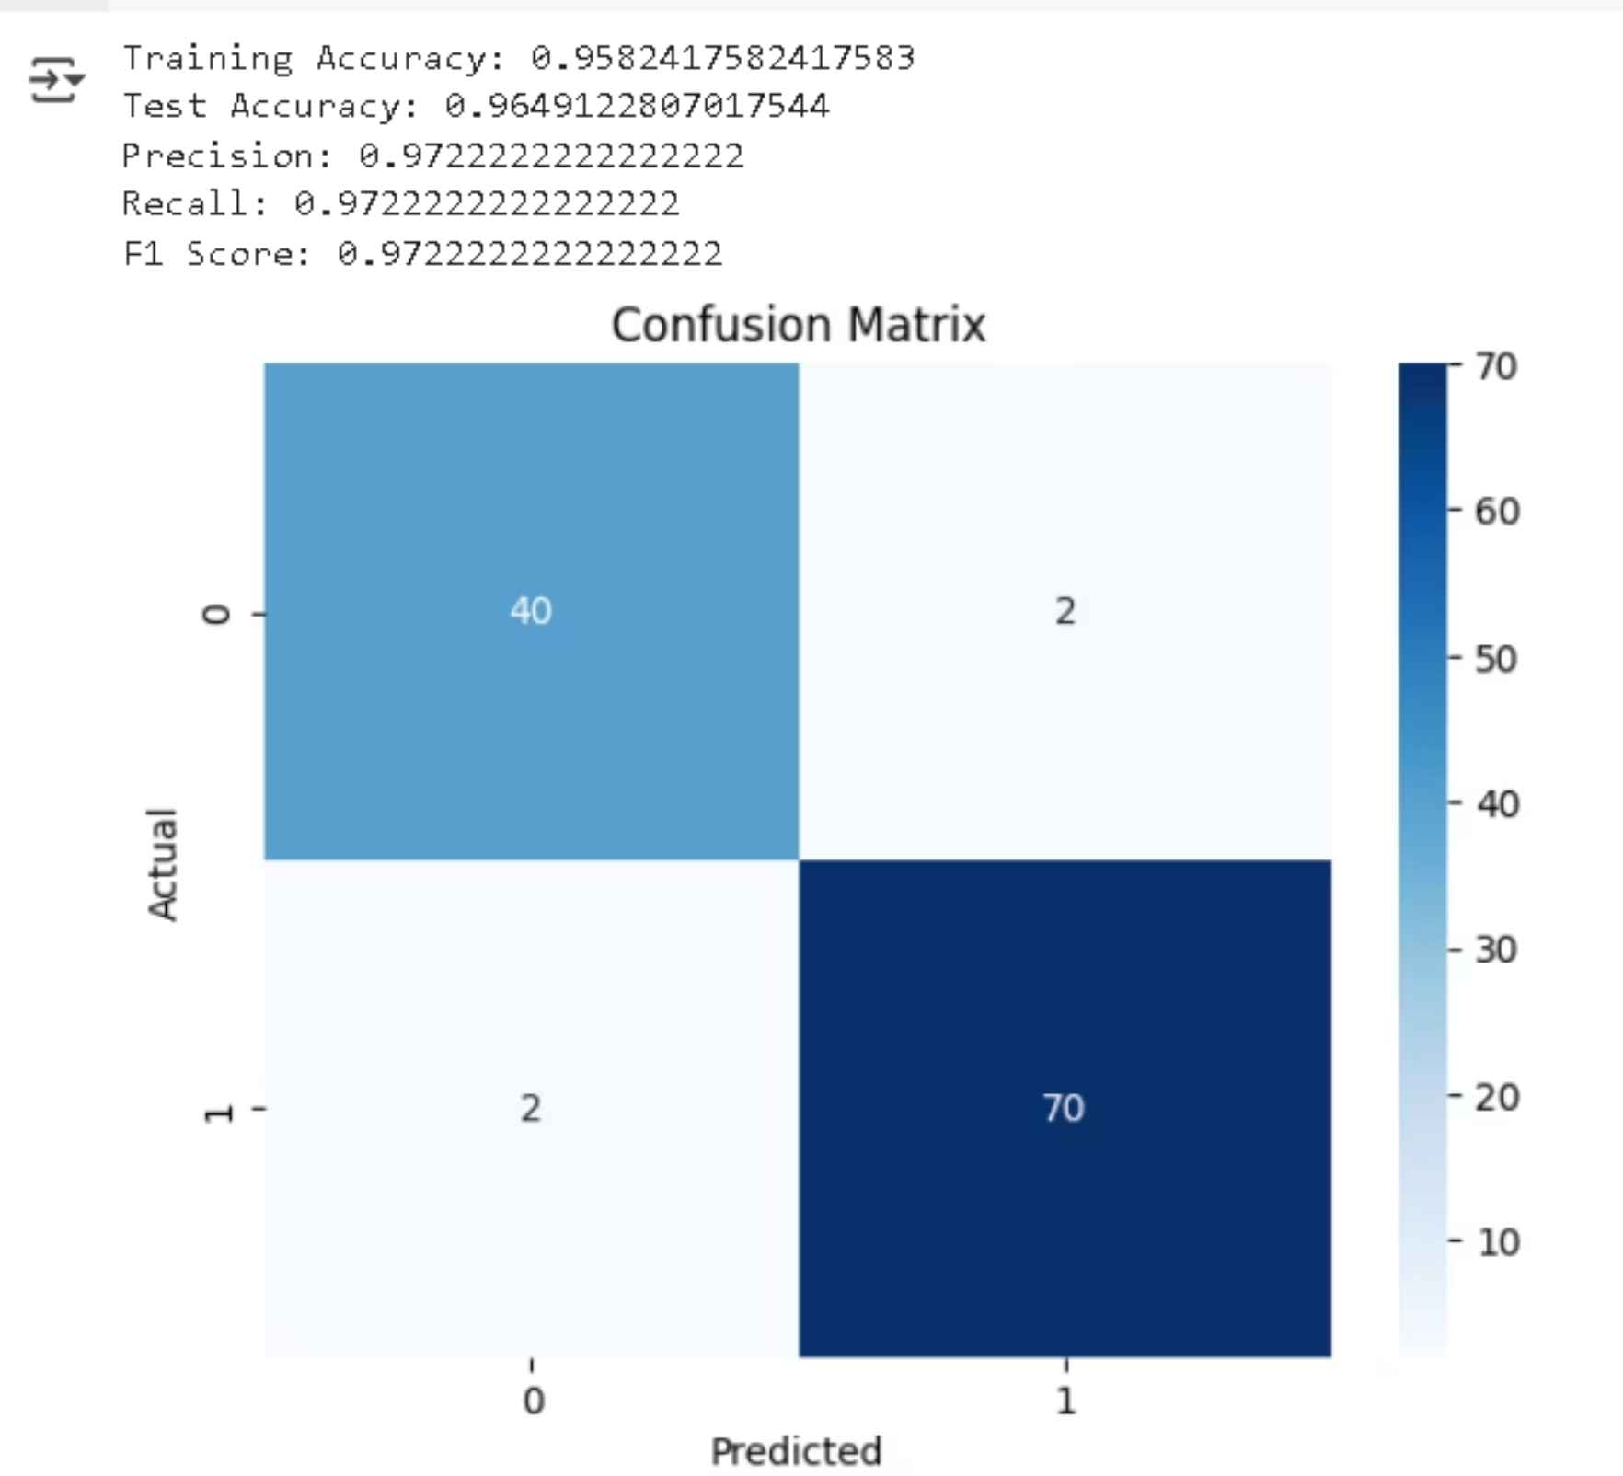
Results:

Slide 11


Building a Predictive System
The trained model can classify new tumor samples with high accuracy.
Sample Prediction
Given a sample input data point with 30 features, the model predicts: The Breast Cancer is Benign.
This system provides a reliable tool for aiding medical professionals in early detection and diagnosis.

Slide 12
key challenges associated with
Breast Cancer Prediction using Logistic Regression
Model Generalization
Limited Feature Diversity
Binary Classification Constraint
Assumption of Linearity

Slide 13
Limitations & Future Work
Current model only trained on one dataset
Limited feature diversity
Future Improvements:
Use of more complex models (e.g., ensemble, deep learning)
Integration with imaging (X-ray, mammograms)
Deployment via web or mobile app

Slide 14

Thank You

